Slide 1
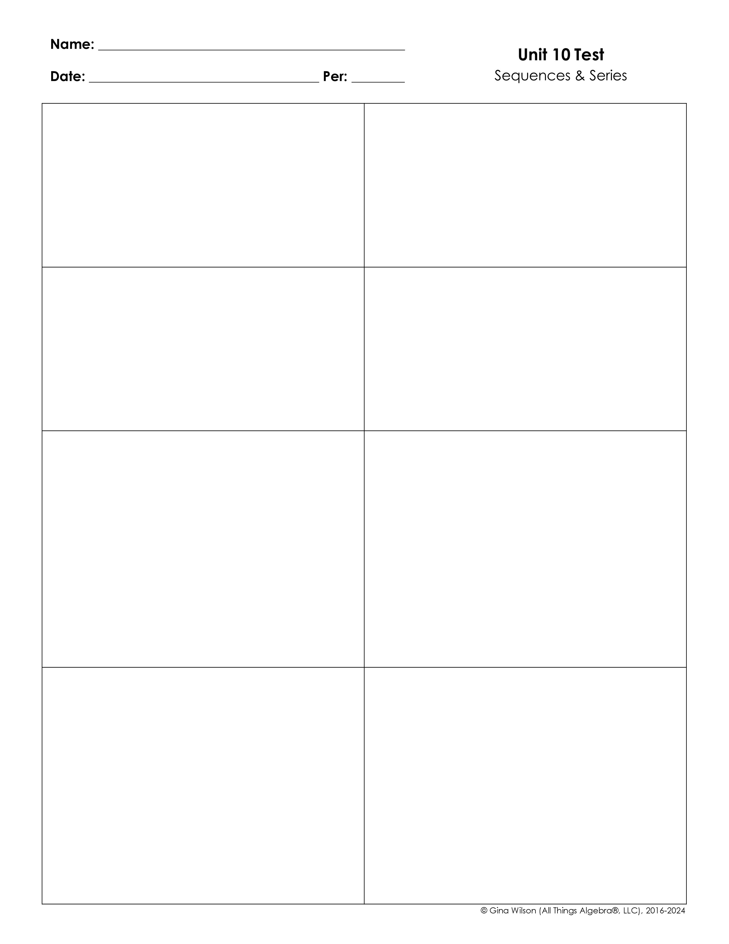
1. Give the first five terms of the sequence:
2. Give the first five terms of the sequence:
(for n ≥ 2)
(for n ≥ 3)
3. Give the first five terms of the sequence:
4. Give the first five terms of the sequence:
5. Which formula can be used to represent the sequence below?
6. Which formula can be used to represent the sequence below?
A. B. C. (for n ≥ 2) D. (for n ≥ 2)
A. B. C. (for n ≥ 2) D. (for n ≥ 2)
7. Find the sum of the first nine terms in the series below.
8. Expand and evaluate the series:

Slide 2
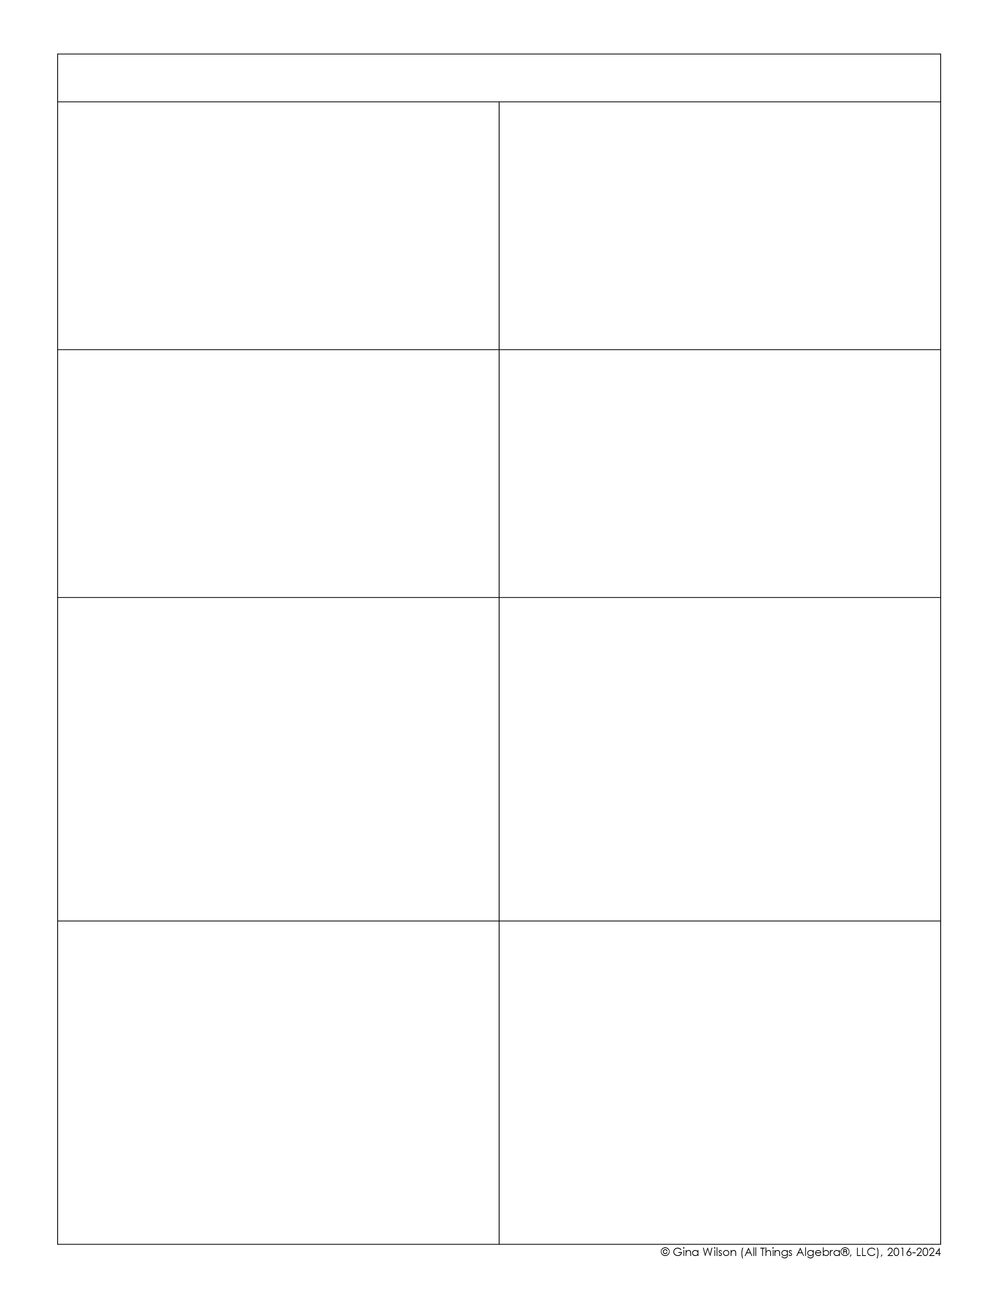
For questions 9-12, describe the sequence as arithmetic, geometric, or neither. For arithmetic and geometric sequences, give the common difference or common ratio.
9.
10.
Type of Sequence
Common Difference/Ratio
Type of Sequence
Common Difference/Ratio
11.
12.
Type of Sequence
Common Difference/Ratio
Type of Sequence
Common Difference/Ratio
13. Identify the formula for the sequence given below.
14. Identify the formula for the sequence given below.
A. B. C. D.
A. C. B. D.
15. Write a formula for the sequence below, then find a₁₀.
16. Write a formula for the sequence below, then find a₄₅.
Formula
Formula
a₁₀ =
a₄₅ =

Slide 3

17. If the information given below represents an arithmetic sequence, find a₁.
18. If the information given below represents an arithmetic sequence, find a₂₇.
and
and
a₁ =
a₂₇ =
19. If the information given below represents a geometric sequence, find a₁.
20. If the information given below represents a geometric sequence, find a₃.
and
and
a₁ =
a₃ =
21. Given the sequence below, find S₁₉.
22. Given the sequence below, find S₈.
A. -573 B. -592 C. -627 D. -649
A. 65535 B. -65535 C. 39321 D. -39321
23. Given the sequence below, find S₇.
24. Given the sequence below, find S₂₅.
A. 6558 B. 6736 C. 7014 D. 7252
A. 208 B. 225 C. 240 D. 272

Slide 4


25. Find the sum:
26. Find the sum:
A. 3806 B. 4074 C. 4182 D. 4468
A. 6483.75 B. 6499.75 C. 16249.375 D. 2593.5
27. Which series do not have a sum? Check all that apply.
28. Find the sum:
29. Find the sum:
A. 10 B. 10.8 C. 48 D. 54
A. C. B. D.
30. Mark got a new job with a starting salary of $32,000. If he gets a yearly raise of 2%, find Mark’s salary after 25 years.

Slide 5

31. An auditorium has 21 rows of seats. The first row has 18 seats, and each succeeding row has two more seats than the previous row. How many seats are in the auditorium?
32. Jalen is in a 24 hour dance-a-thon as part of a fundraiser. He raised $50 in the first hour of the competition, then another $60 in the second hour, then another $72 in the third hour. If this pattern continues, what is the total amount of money he will raise if he stays for the entire competition?

